Slide 1



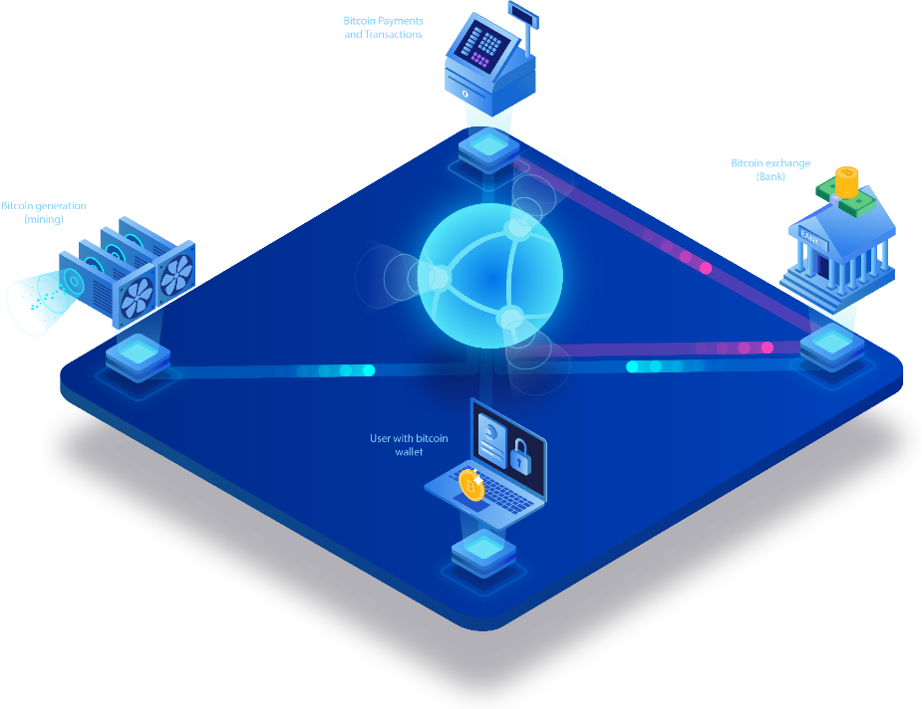

Sierra Wireless
FINAL PROJECT REPORT
Internship – batch ${26}^{th}$
Mentor: Nguyen Xuan Thong
Reported by: Phan Thanh Tung
1

Slide 2

CONTENTS
1
2
Key deliverables
Requirements of project
Some requirements before starting the project
Come up with resolution and final required product
3
Results achieved according to the project
4
Demo
Testing the model
Introduce about the model of product and project
5
Lessons learnt & Best practices during internship
Sharing experience and lessons have learnt after the Internship term
2

Slide 3

01
REQUIREMENTS OF PROJECT
Some requirements before starting the project
3

Slide 4











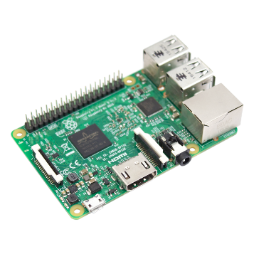

> 65%
now
2020
64 million internet users, accounting for 66% of the population
35% - 40%
in early 2020
2018
One-third (1/3) of the population, or 30 million Vietnamese, have been buying online, especially in 2018.
Vietnamese Consumers
On average, each Vietnamese person possesses 1.5 devices connected to the internet.
According to the management of Vietnam, e-commerce growth rate of Vietnam will reach about 30%, however, this figure is actually above 35% and can reach the level more than 40% in the coming years.
NAME OF THE PROJECT
“IoT and Blockchain Applications in Logistics & Supply chain”with Raspberry Pi 3
4

Slide 5



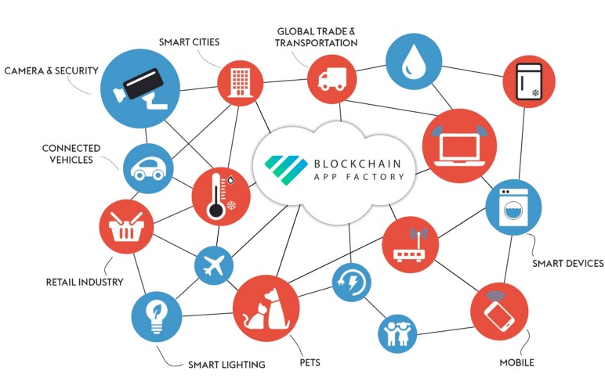


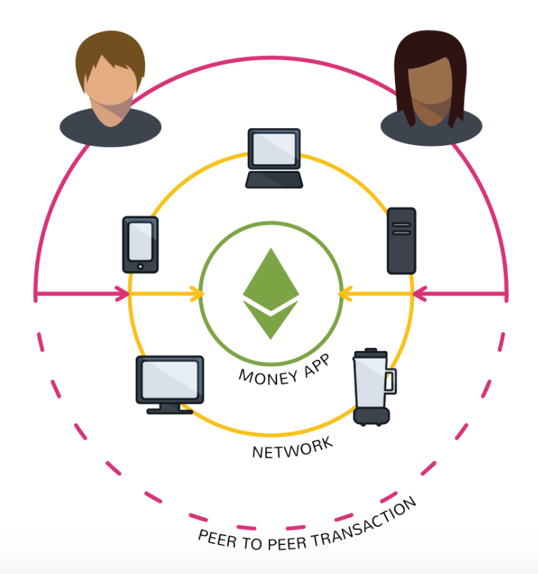
Requirements of THE PROJECT
Blockchain – Framework on RPi and Linux
Understand the way to setup Ethereum Blockchain on Raspberry Pi and Ubuntu with Geth, which provides command line interface for running a full ethereum node in 'Go'.
IoT Blockchain
Research and understand about Blockchain, IoT Blockchain.
Web3js – NodeJS
Uses case in Logistics
Proficient using web3js and knowing how to work with NodeJS, module npm to control Ethereum and DApp.
Known how can IoT Blockchain helps in Logistics ?
Smart Contract
DApp – Final product
Could be able to write a Smart Contract (.sol) with any functions with suitable for the requirements of project
Done the front-end (Web UI) and back-end (communicate environment with Ethereum Blockchain & Smart Contract)
5

Slide 6
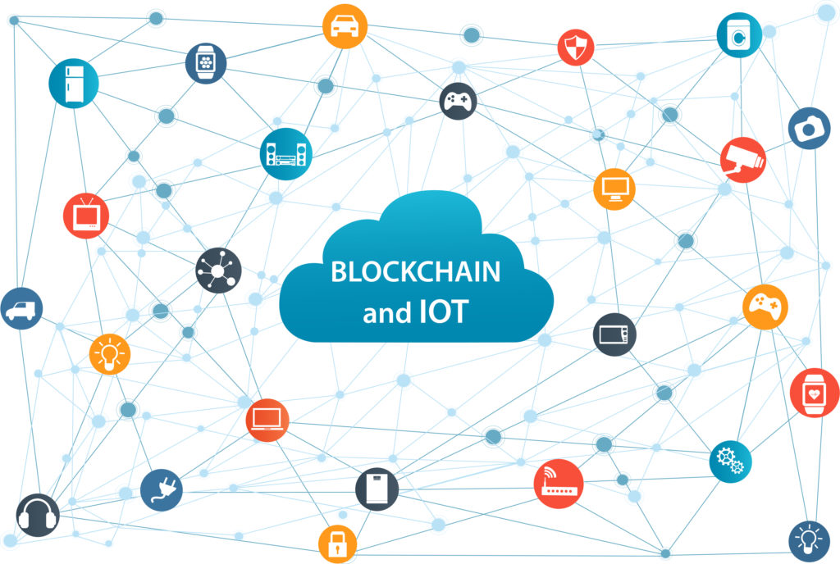
02
KEY DELIVERABLES
Come up with resolution and required for final product
6

Slide 7


IoT and Blockchain integration
POPULARITY
More and more people need to use.
STRONG GROWTH - INCREASE
Significant development, growth up with a huge numbers.
ACTUAL DEMAND – THE NEED
Ensuring right and trust from consumers.
APPLY NEW TECHNOLOGY
Approach with new technology development, a good opportunity for both developers and enterprises.
7

Slide 8
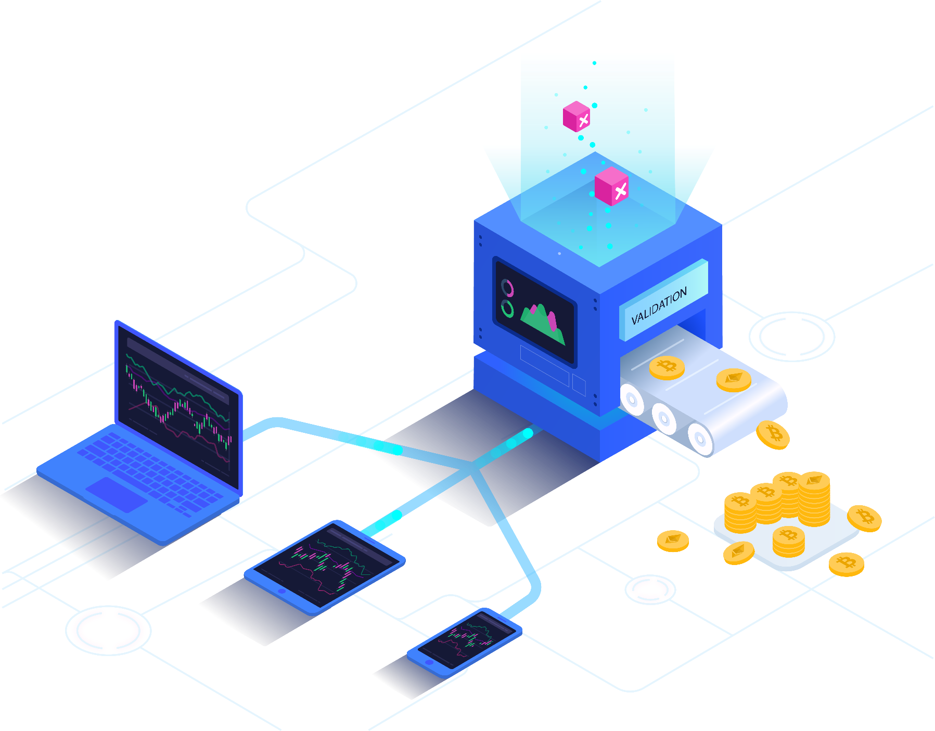



Internet of Things
Blockchain Technology
IoT Analytics predicts the global market for Internet of Things is expected to grow 15% from 2019 to $123B in 2021.
A Young Technology That Could Change Everything
8

Slide 9
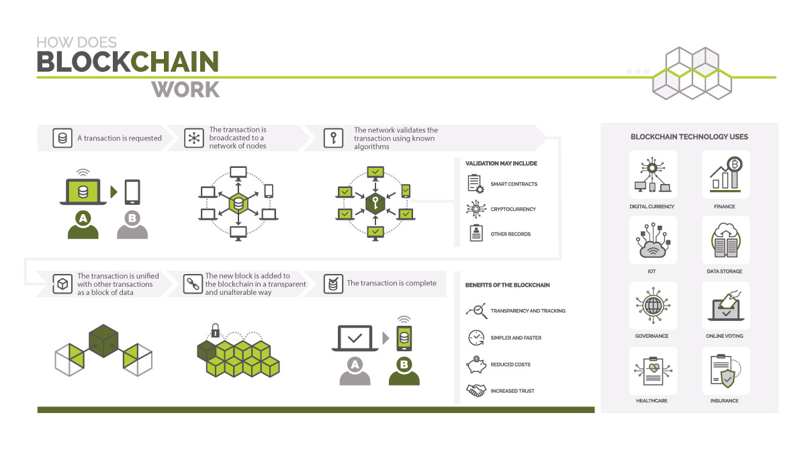
9

Slide 10
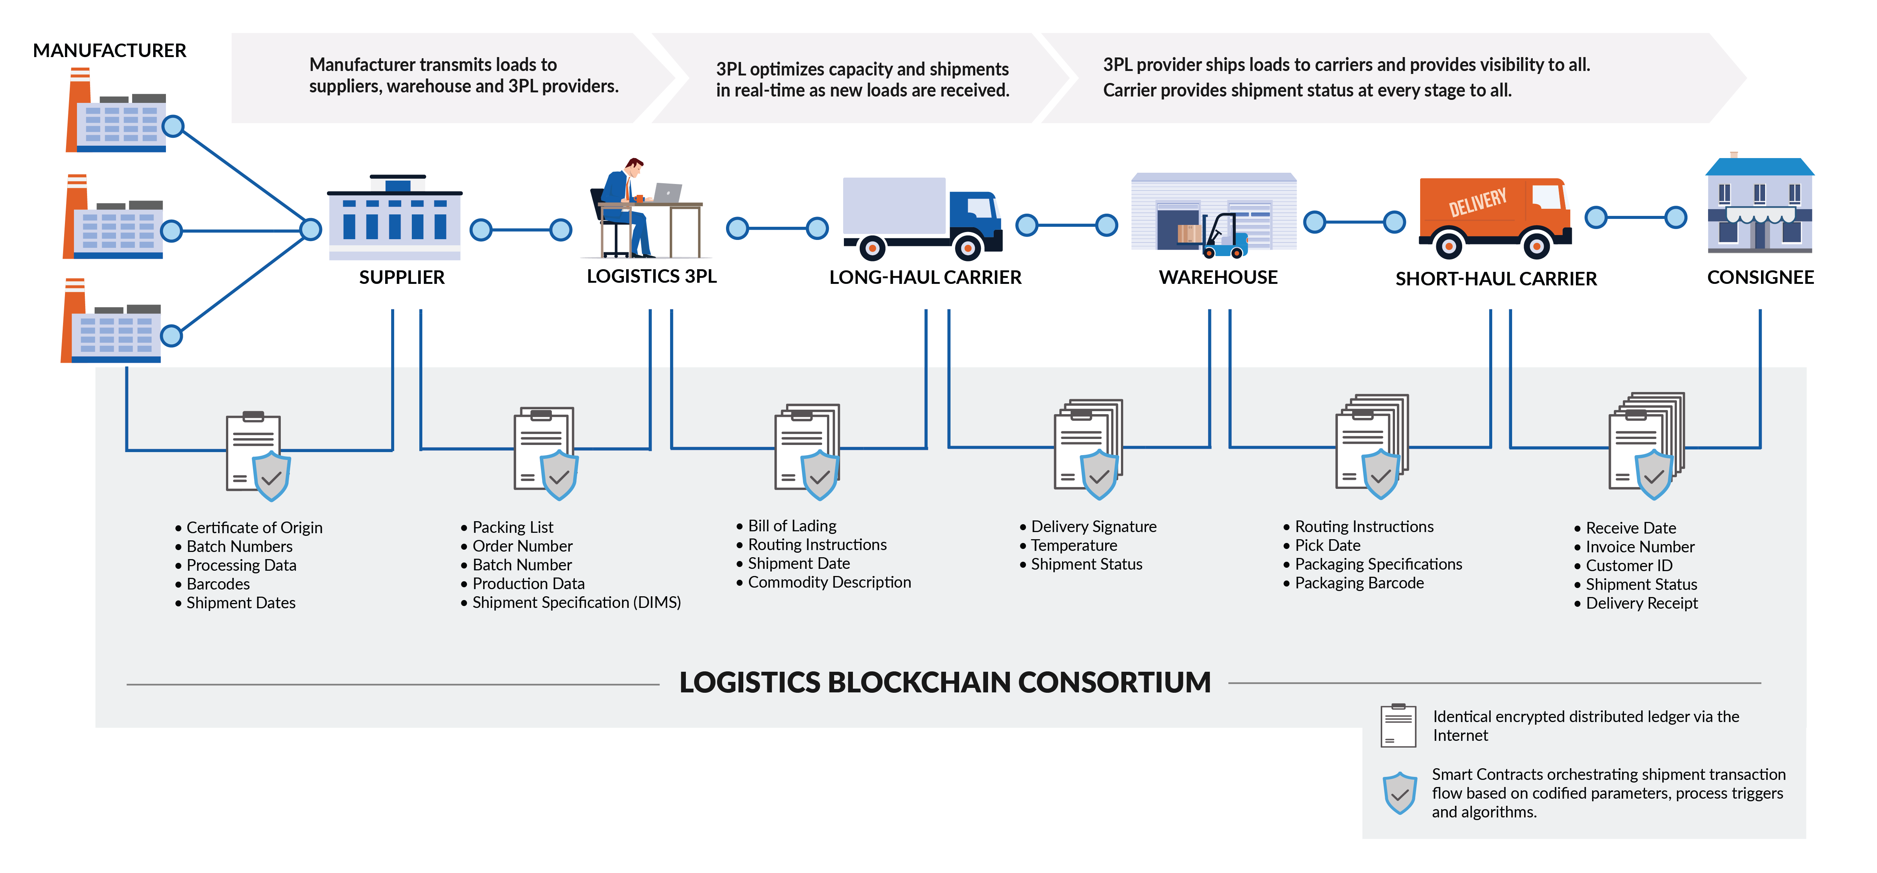
Sample of processing’s product
10

Slide 11
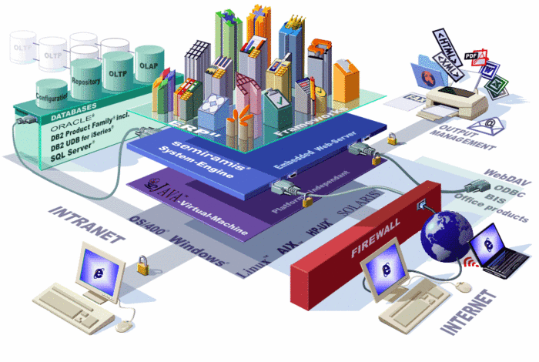
03
RESULTS ACHIEVED ACCORDING TO THE PROJECT
Introduce about the model of product and project
11

Slide 12

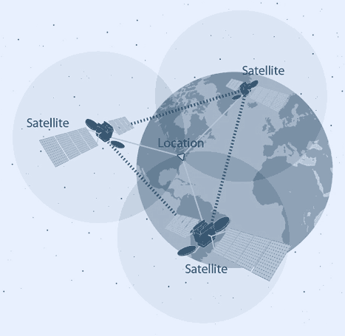
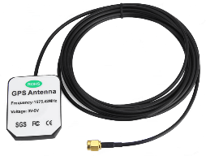
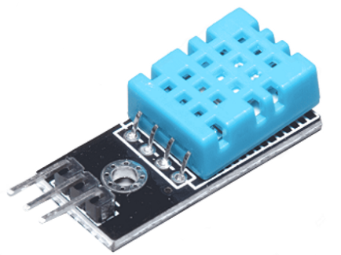

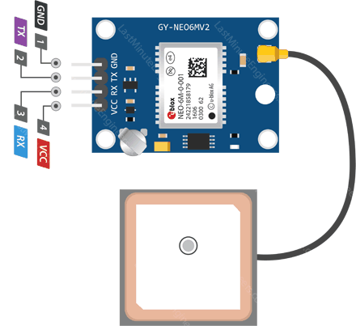









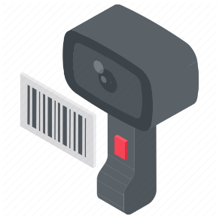
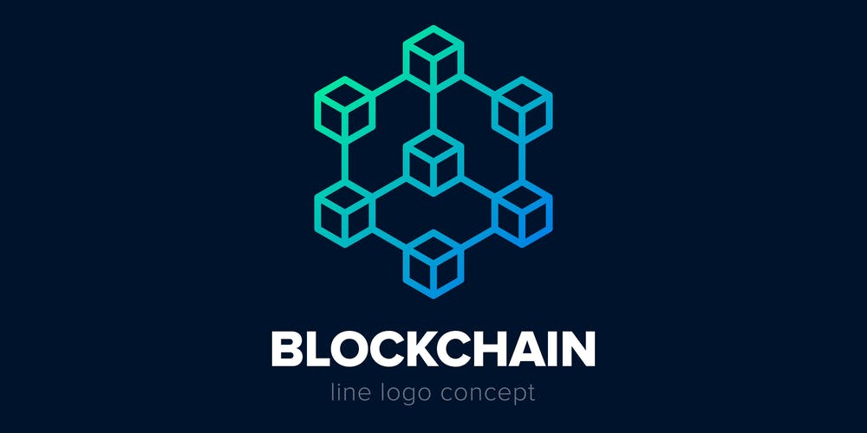
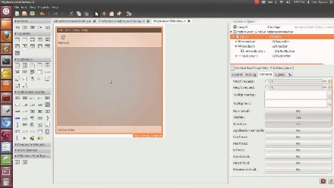



The sample model of project
Anten GPS 1575.42 MHz
Input from GUI
Module GPS U-Blox NEO 6-M
DHT11 Sensor
transport
import
Certificate of Origin
Certificate of Quality
Batch Numbers
Barcodes
Processing Data
Auto Detect
RaspNode #1
Shipment Dates
Location
Status: Temperature – Humidity
GUI
Barcode Scanner
RaspNode #n
12

Slide 13
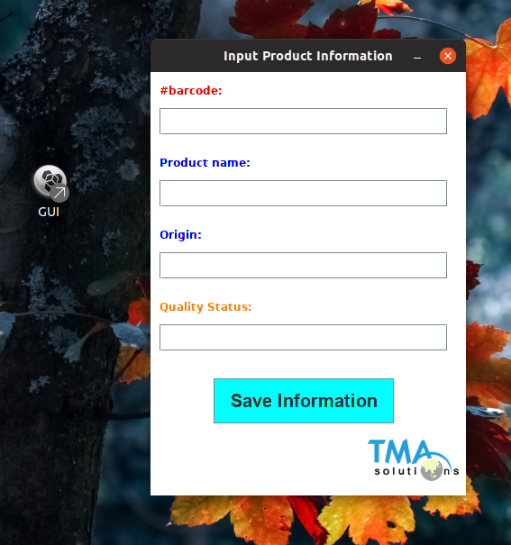
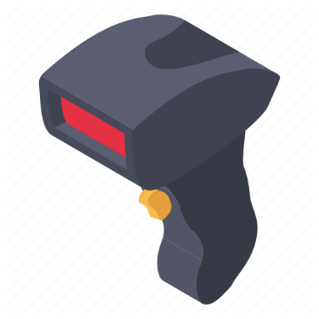






The sample model
BASIC JAVA SWING GUI
BASIC INPUT INFORMATION
“WRITE ONCE – RUN ANYWHERE”
13

Slide 14
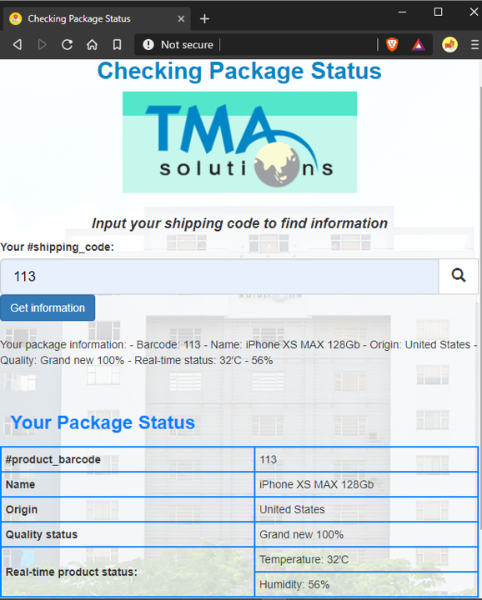


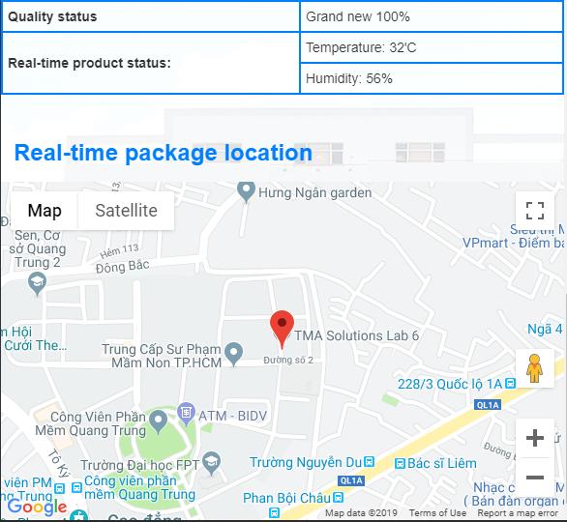

The sample model of project
PC – WEBSITE
CUSTOMER
MOBILE APP
14

Slide 15

04
DEMO
Testing the model
15

Slide 16

05
LESSONS LEANT & BEST PRACTICES DURING INTERNSHIP
Sharing experience and lessons have learnt after the Internship term
16

Slide 17
EXPERIENCES & LESSONS
WORKING LIFESTYLE
MORE ACTIVE
PRESENTATION SKILL
RESEARCHING
Learn how to work punctually with efficient way. Writing skills – how to write daily and weekly project status report.
The more active to learn the new technology. The more easier to adapt to suddenly problem occurred
Better in searching and reading documents in English Known the place having good and reliable references
Training my presentation skills with more confident and clearly expression. Making more impressive slideshow.
17

Slide 18
EXPERIENCES & LESSONS
Teamwork Skills
Know how to work in a reality project
Training my brainstorm skills
Good at co-operate with new colleagues
Improve in the way using English to communicate
More confident and more active
18

Slide 19

Sierra Wireless
THANK YOU
FOR YOUR REVIEWING
FINAL PROJECT REPORT
Internship – batch ${26}^{th}$
Mentor: Nguyen Xuan Thong
Reported by: Phan Thanh Tung
19

